Slide 1
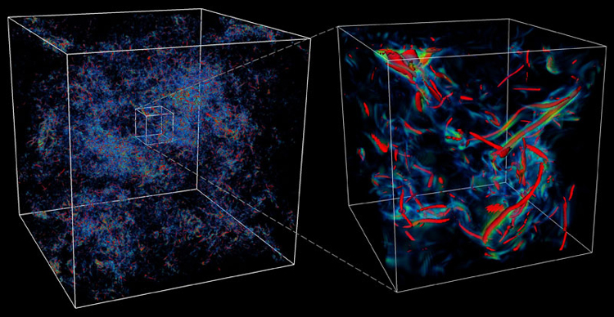
PHYS 8750 Numerical Fluid Dynamics
Fall, 2020
Isotropic turbulence, Donzis and Yeung. http://www.tacc.utexas.edu/scivis-gallery/isotropic-turbulence

Slide 2
PHYS 8750
Outline
Shallow-water equations
Discrete-dispersion method
Staggered grid for shallow-water equations.
Staggered in space
Staggered in space & time
Forward-backward differencing
Examples (Codes)
Advantages/disadvantages
Class #11 (Chapter 4.1)
1) PDE with two variables
2) Shallow-water equations
3) Staggered grids in time
Class #12 (Chapter 4.1, 4.2)
Staggered grids in time and space

Slide 3
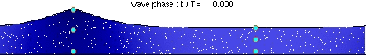
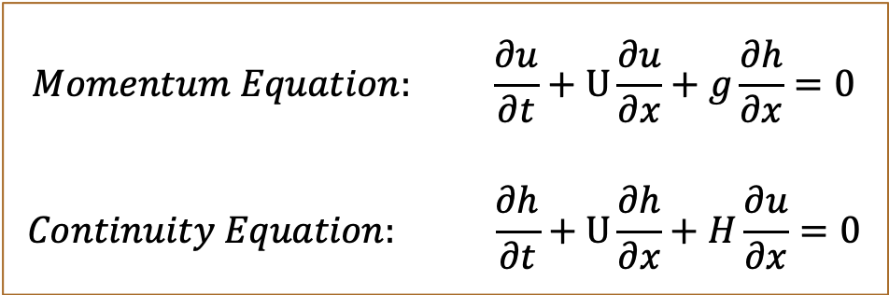
Shallow-Water Equations
$$Momentum Equation: \frac{∂u}{∂t}+U\frac{∂u}{∂x}+g\frac{∂h}{∂x}=0$$
$$Continuity Equation: \frac{∂h}{∂t}+U\frac{∂h}{∂x}+H\frac{∂u}{∂x}=0$$
Shallow-Water
Equations:
Physics:
Higher depth would be pulled down by gravity, which leads to horizontal motions.
Building up of horizontal motions will lead to changes to water depths.
Addition to this: advection of water depth and velocity by the mean flow.

Slide 4
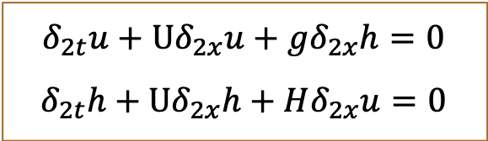
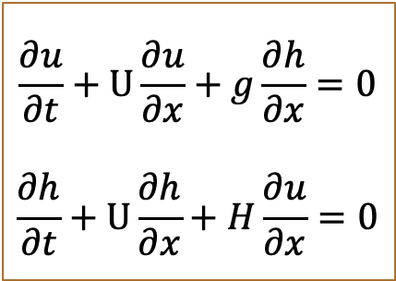
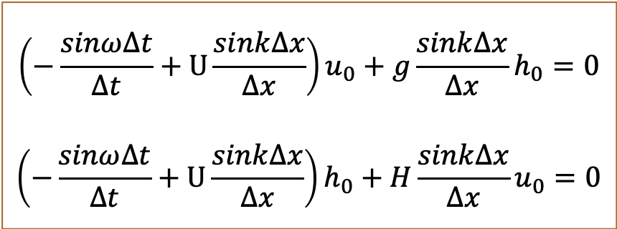
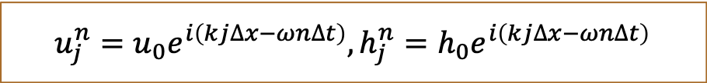
Discrete-Dispersion Relation
$$\frac{∂u}{∂t}+U\frac{∂u}{∂x}+g\frac{∂h}{∂x}=0$$
$$\frac{∂h}{∂t}+U\frac{∂h}{∂x}+H\frac{∂u}{∂x}=0$$
leapfrog
$$δ_{2t}u+Uδ_{2x}u+gδ_{2x}h=0$$
$$δ_{2t}h+Uδ_{2x}h+Hδ_{2x}u=0$$
Center space
$$u_{j}^{n}=u_{0}e^{i\left(kj∆x−ωn∆t\right)},h_{j}^{n}=h_{0}e^{i\left(kj∆x−ωn∆t\right)}$$
$$\left(−\frac{sinω∆t}{∆t}+U\frac{sink∆x}{∆x}\right)u_{0}+g\frac{sink∆x}{∆x}h_{0}=0$$
$$\left(−\frac{sinω∆t}{∆t}+U\frac{sink∆x}{∆x}\right)h_{0}+H\frac{sink∆x}{∆x}u_{0}=0$$

Slide 5
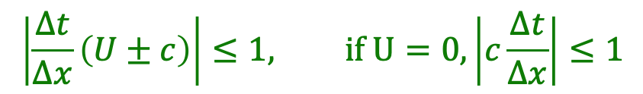
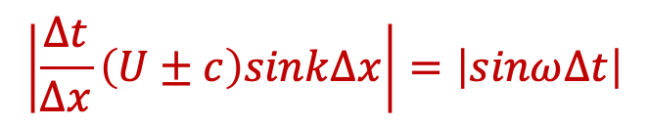
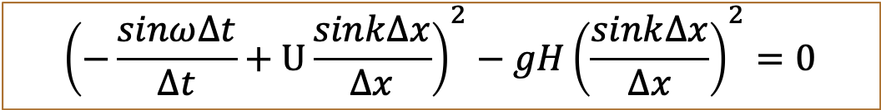
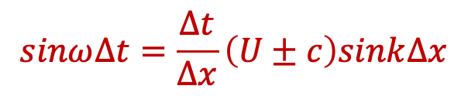
Discrete-Dispersion Relation
$${\left(−\frac{sinω∆t}{∆t}+U\frac{sink∆x}{∆x}\right)}^{2}−gH{\left(\frac{sink∆x}{∆x}\right)}^{2}=0$$
Define $c=\sqrt{gH},$ discrete-dispersion relation:
$$sinω∆t=\frac{∆t}{∆x}\left(U±c\right)sink∆x$$
If $ω=ω_{r}+iω_{i},$ then $ω_{r}$determines wave phase, $ω_{i}$gives growth rates
To avoid amplitude growth, $ω$ cannot have imaginary part:
$$\left|\frac{∆t}{∆x}\left(U±c\right)sink∆x\right|=\left|sinω∆t\right|$$
To satisfy this relation anytime:
$$\left|\frac{∆t}{∆x}\left(U±c\right)\right|≤1, if U=0,\left|c\frac{∆t}{∆x}\right|≤1$$

Slide 6
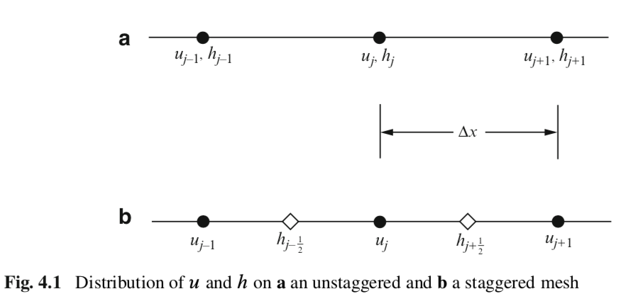
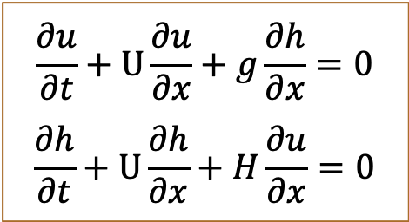
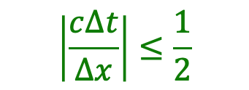
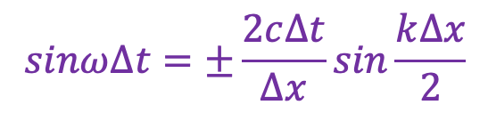
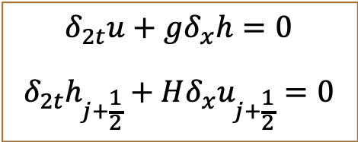
Staggered grids: shallow-water eqs
$$\frac{∂u}{∂t}+U\frac{∂u}{∂x}+g\frac{∂h}{∂x}=0$$
$$\frac{∂h}{∂t}+U\frac{∂h}{∂x}+H\frac{∂u}{∂x}=0$$
Unstaggered
Staggered
$$δ_{2t}u+gδ_{x}h=0$$
$$δ_{2t}h_{j+\frac{1}{2}}+Hδ_{x}u_{j+\frac{1}{2}}=0$$
Durran’s book
Discrete-dispersion relation:
$$sinω∆t=±\frac{2c∆t}{∆x}sin\frac{k∆x}{2}$$
$$\left|\frac{c∆t}{∆x}\right|≤\frac{1}{2}$$
Stability criterion: , more strict than unstaggered grid scheme.

Slide 7
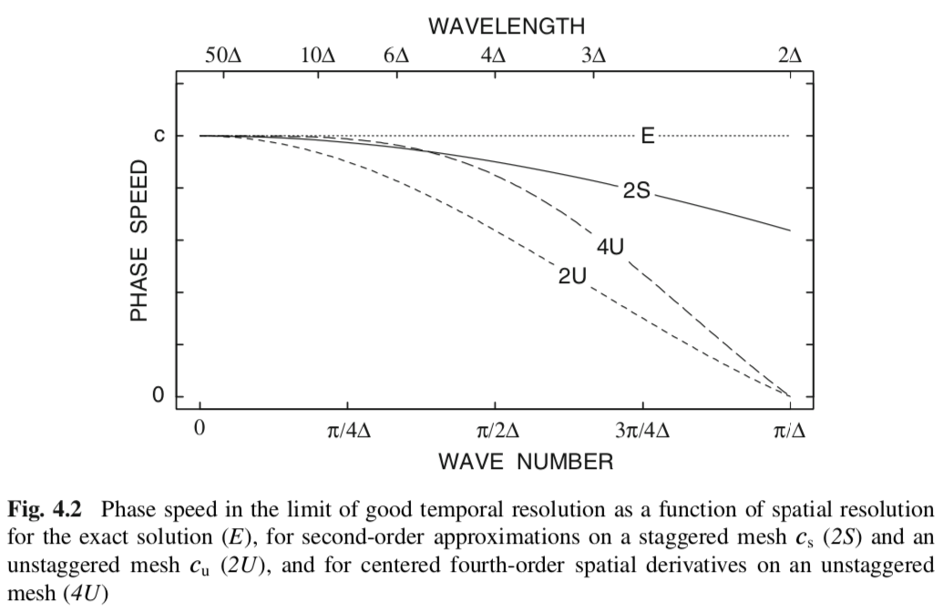
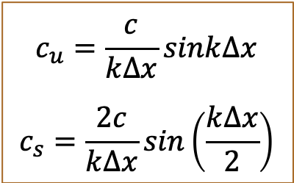
Superior Property of Staggered Grid
Durran’s book
$$c_{u}=\frac{c}{k∆x}sink∆x$$
$$c_{s}=\frac{2c}{k∆x}sin\left(\frac{k∆x}{2}\right)$$
Staggered grid: smaller differences in phases & less dispersive.
Phase
speeds:

Slide 8
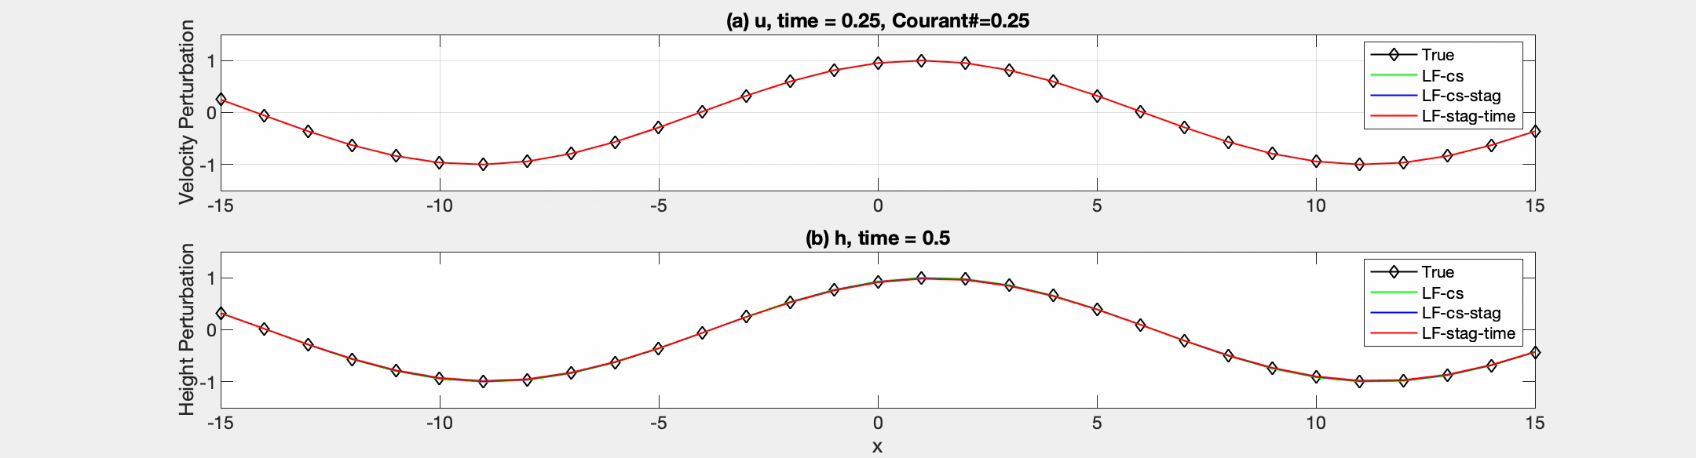
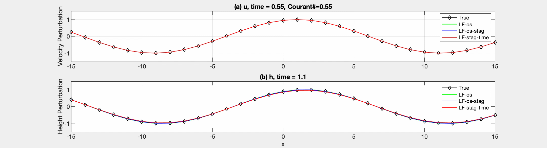
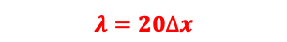
Programming & Comparison of Staggered and Unstaggered Schemes
U=0
$$λ=20∆x$$
U=0

Slide 9
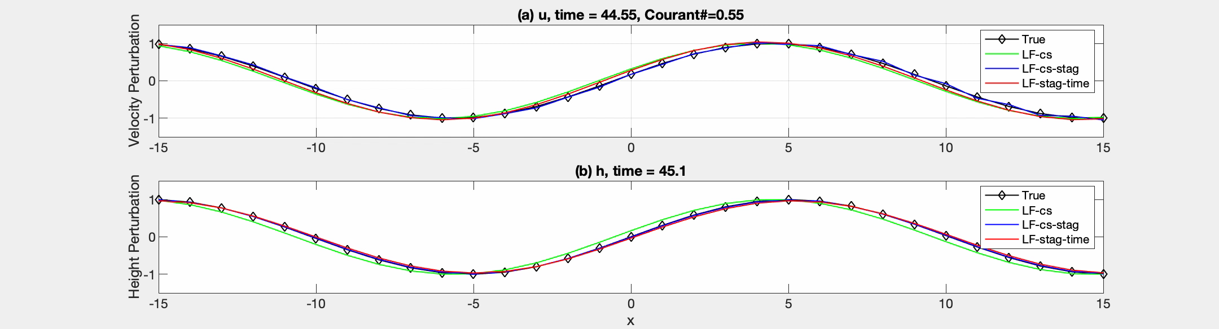
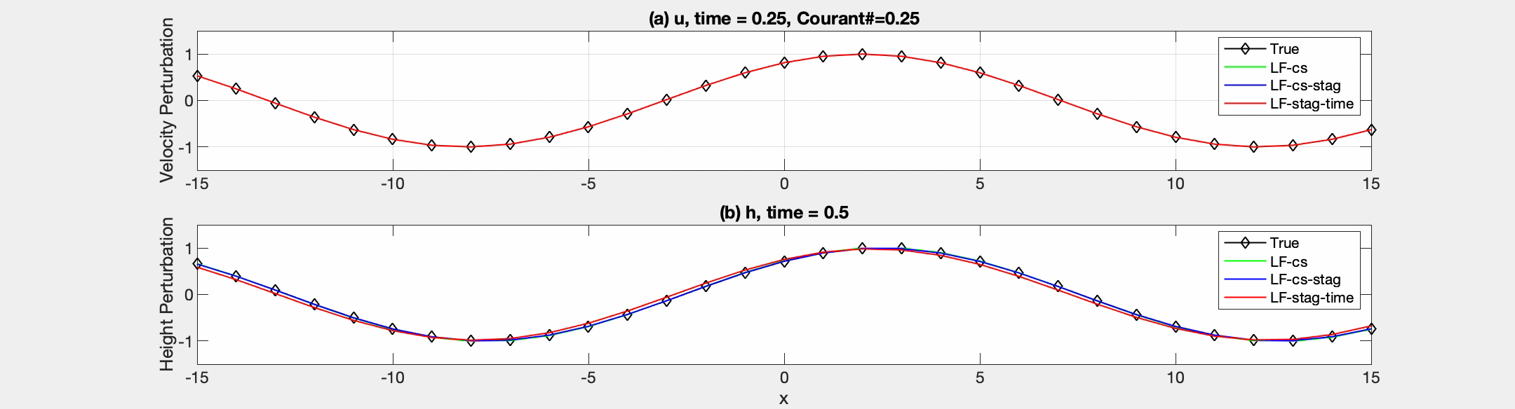

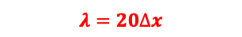
Programming & Comparison of Staggered and Unstaggered Schemes
$$λ=20∆x$$
U=0
$$λ=20∆x$$
U=1

Slide 10
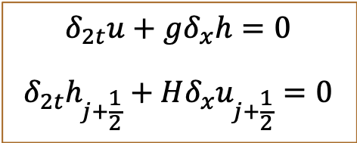
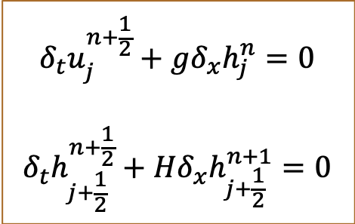
Temporal Staggering
$$\frac{∂u}{∂t}+U\frac{∂u}{∂x}+g\frac{∂h}{∂x}=0$$
$$\frac{∂h}{∂t}+U\frac{∂h}{∂x}+H\frac{∂u}{∂x}=0$$
Unstaggered
Staggered
Stagger in space
Stagger in time
Durran’s book
$$δ_{t}u_{j}^{n+\frac{1}{2}}+gδ_{x}h_{j}^{n}=0$$
$$δ_{t}h_{j+\frac{1}{2}}^{n+\frac{1}{2}}+Hδ_{x}h_{j+\frac{1}{2}}^{n+1}=0$$
$$δ_{2t}u+gδ_{x}h=0$$
$$δ_{2t}h_{j+\frac{1}{2}}+Hδ_{x}u_{j+\frac{1}{2}}=0$$
Time step is divided by 2

Slide 11
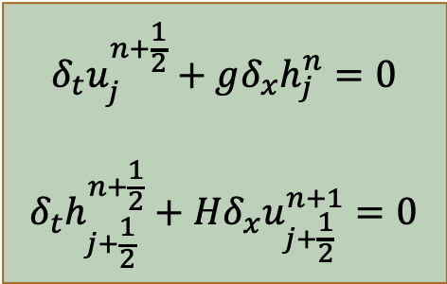
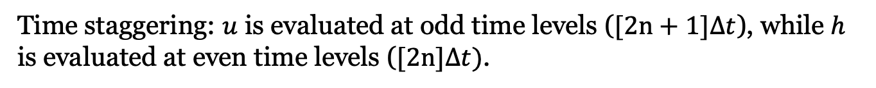
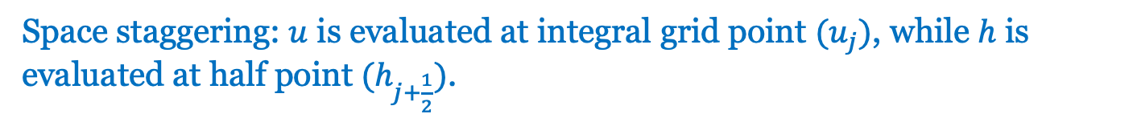
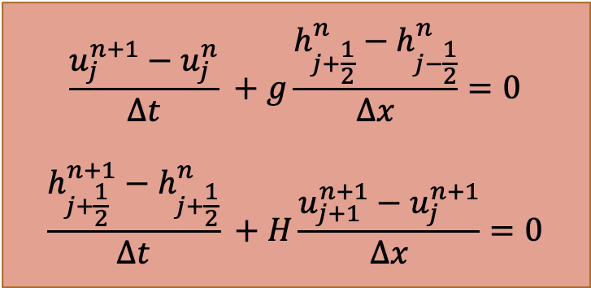
Forward-Backward Differencing
$$\frac{u_{j}^{n+1}−u_{j}^{n}}{∆t} +g\frac{h_{j+\frac{1}{2}}^{n}−h_{j−\frac{1}{2}}^{n}}{∆x}=0$$
$$\frac{h_{j+\frac{1}{2}}^{n+1}−h_{j+\frac{1}{2}}^{n}}{∆t} +H\frac{u_{j+1}^{n+1}−u_{j}^{n+1}}{∆x}=0$$
$$δ_{t}u_{j}^{n+\frac{1}{2}}+gδ_{x}h_{j}^{n}=0$$
$$δ_{t}h_{j+\frac{1}{2}}^{n+\frac{1}{2}}+Hδ_{x}u_{j+\frac{1}{2}}^{n+1}=0$$
Space staggering: $u$ is evaluated at integral grid point $(u_{j})$, while $h$ is evaluated at half point $(h_{j+\frac{1}{2}})$.
Time staggering: $u$ is evaluated at odd time levels ($[2n+1]∆t$), while $h$ is evaluated at even time levels ($[2n]∆t)$.

Slide 12
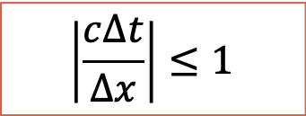
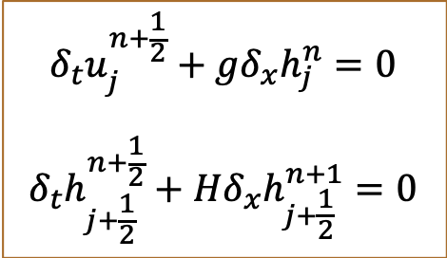
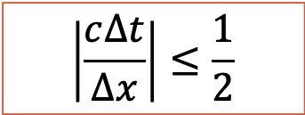
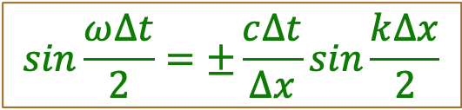
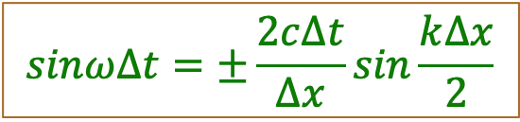
Discrete-Dispersion Relation
Stagger in time and space
Stagger in time
$$δ_{t}u_{j}^{n+\frac{1}{2}}+gδ_{x}h_{j}^{n}=0$$
$$δ_{t}h_{j+\frac{1}{2}}^{n+\frac{1}{2}}+Hδ_{x}h_{j+\frac{1}{2}}^{n+1}=0$$
$$δ_{2t}u+gδ_{x}h=0$$
$$δ_{2t}h_{j+\frac{1}{2}}+Hδ_{x}u_{j+\frac{1}{2}}=0$$
$$sinω∆t=±\frac{2c∆t}{∆x}sin\frac{k∆x}{2}$$
$$sin\frac{ω∆t}{2}=±\frac{c∆t}{∆x}sin\frac{k∆x}{2}$$
Stability criterion is relaxed in staggered grids in both time and space
$$\left|\frac{c∆t}{∆x}\right|≤\frac{1}{2}$$
$$\left|\frac{c∆t}{∆x}\right|≤1$$

Slide 13
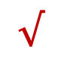

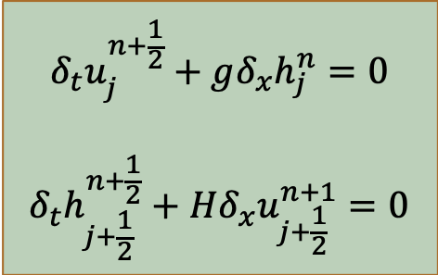



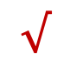
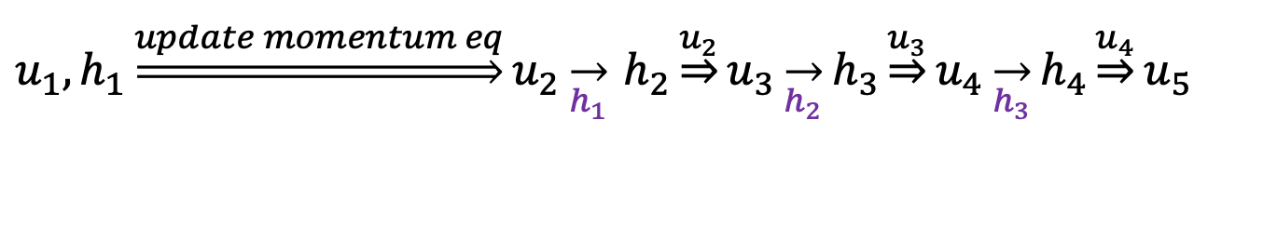

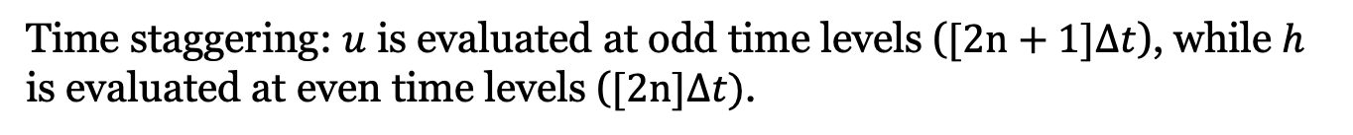
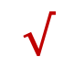
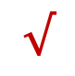
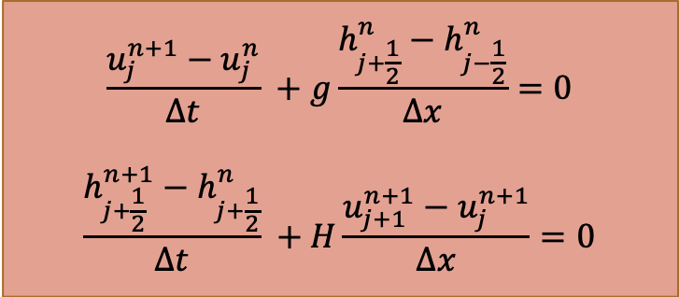
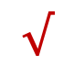

Forward-Backward Differencing
$$\frac{u_{j}^{n+1}−u_{j}^{n}}{∆t} +g\frac{h_{j+\frac{1}{2}}^{n}−h_{j−\frac{1}{2}}^{n}}{∆x}=0$$
$$\frac{h_{j+\frac{1}{2}}^{n+1}−h_{j+\frac{1}{2}}^{n}}{∆t} +H\frac{u_{j+1}^{n+1}−u_{j}^{n+1}}{∆x}=0$$
$$δ_{t}u_{j}^{n+\frac{1}{2}}+gδ_{x}h_{j}^{n}=0$$
$$δ_{t}h_{j+\frac{1}{2}}^{n+\frac{1}{2}}+Hδ_{x}u_{j+\frac{1}{2}}^{n+1}=0$$
Time staggering: $u$ is evaluated at odd time levels ($[2n+1]∆t$), while $h$ is evaluated at even time levels ($[2n]∆t)$.
$u_{1},h_{1}\underset{⇒}{update momentum eq}u_{2}\overset{→}{h_{1}}$ $h_{2}\underset{⇒}{u_{2}}u_{3}\overset{→}{h_{2}}h_{3}\underset{⇒}{u_{3}}u_{4}\overset{→}{h_{3}}h_{4}\underset{⇒}{u_{4}}u_{5}$
Storage:
$$×$$
$$√$$
$$√$$
$$×$$
$$×$$
$$√$$
$$√$$
$$√$$
$$×$$
$$×$$
$$√$$
$$√$$
$$×$$
$$×$$
$u$at even time levels, $h$at odd time levels are all intermediate values: SAVE STORAGE. (go to code)

Slide 14
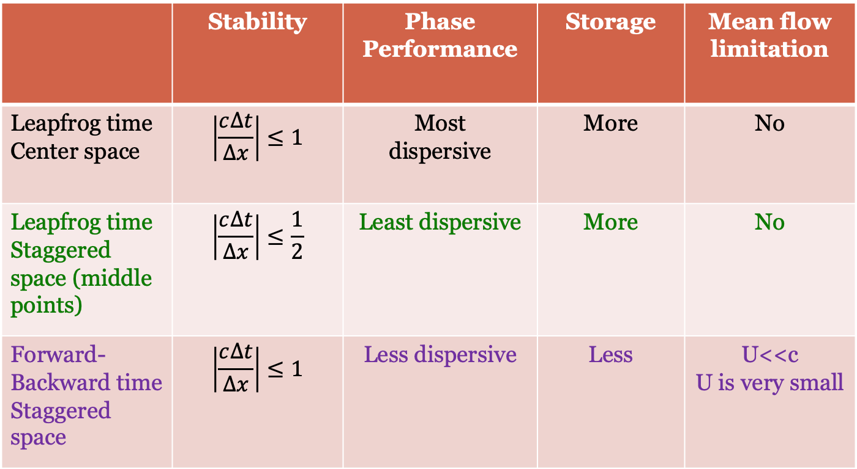
Advantage/Disadvantage
 | Stability | Phase Performance | Storage | Mean flow limitation
Leapfrog time Center space | $$\left|\frac{c∆t}{∆x}\right|≤1$$ | Most dispersive | More | No
Leapfrog time Staggered space (middle points) | $$\left|\frac{c∆t}{∆x}\right|≤\frac{1}{2}$$ | Least dispersive | More | No
Forward-Backward time Staggered space | $$\left|\frac{c∆t}{∆x}\right|≤1$$ | Less dispersive | Less | U<<c U is very small

